Slide 1
Flight
Price Prediction

Slide 2
Problem Statement
Anyone who has booked a flight ticket knows how unexpectedly the prices vary. The cheapest available ticket on a given flight gets more and less expensive over time. This usually happens as an attempt to maximize revenue based on :
Time of purchase patterns (making sure last-minute purchases are expensive)
Keeping the flight as full as they want it (raising prices on a flight which is filling up in order to reduce sales and hold back inventory for those expensive last-minute expensive purchases)
So, I have to work on a project where i collect data of flight fares with other features and work to make a model to predict fares of flights.

Slide 3
About Dataset
There are 9598 rows and 9 columns in the dataset.
All columns are of object type.
There are no null values in the dataset.

Slide 4
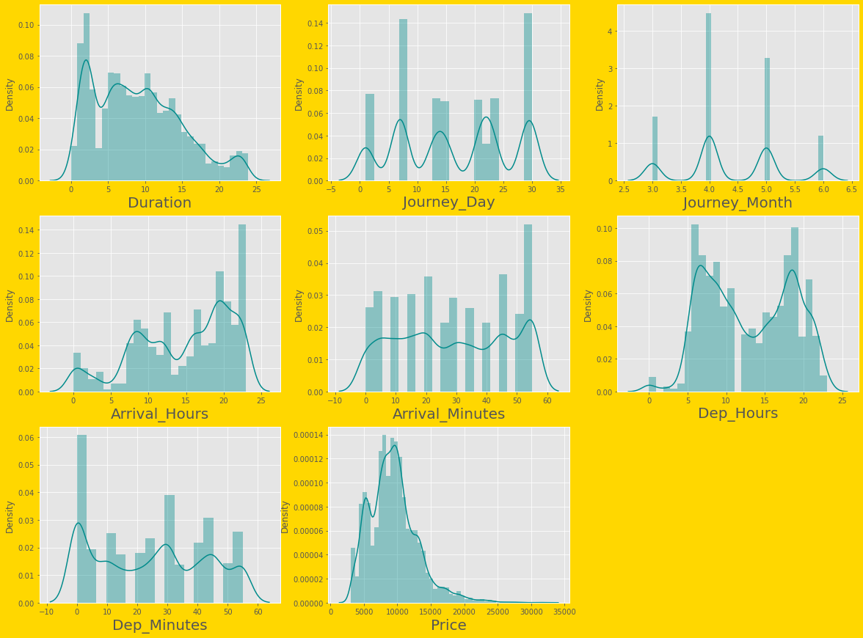
Exploratory Data Analysis
a).Univariate Analysis:

Slide 5
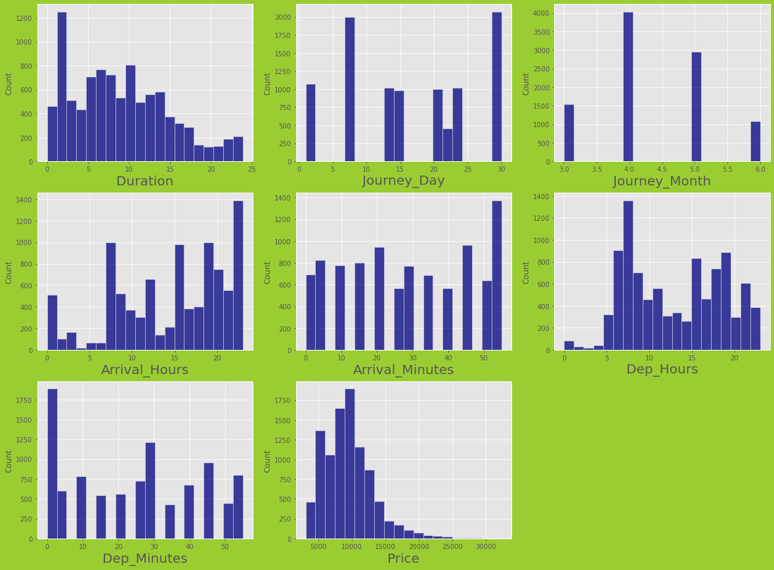

Slide 6
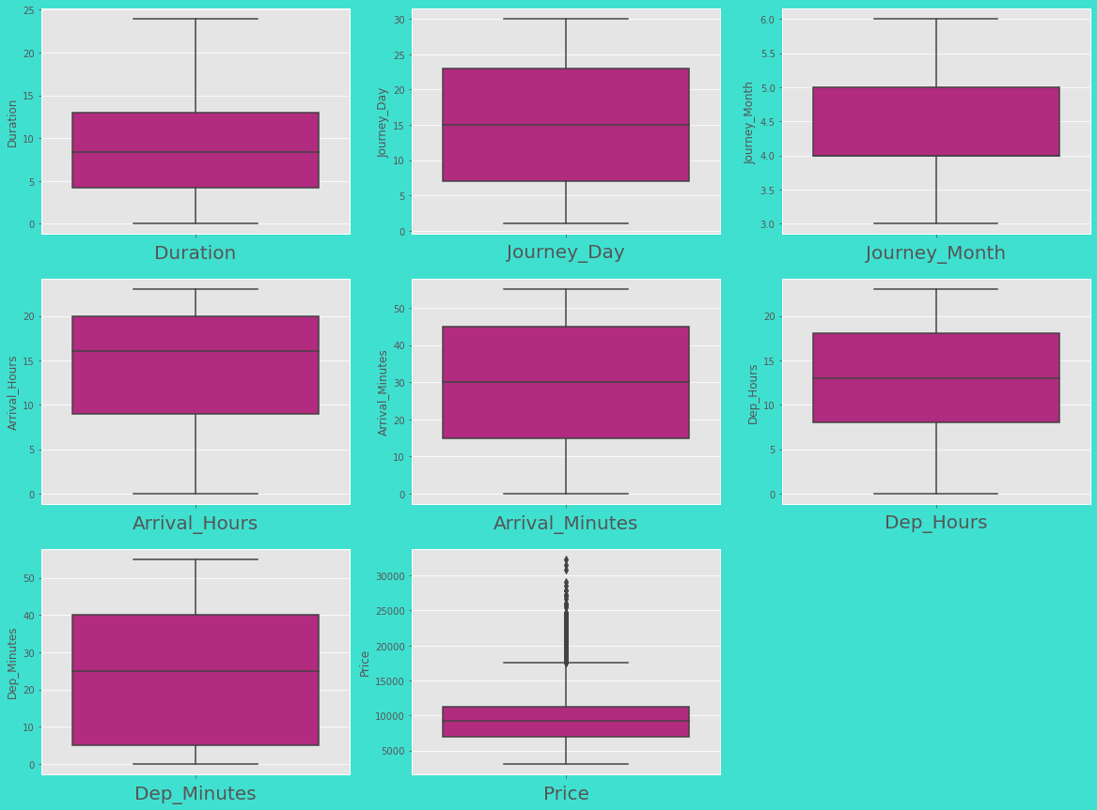

Slide 7
From these graph, it is observed that data is not normally distributed.
There is some skewness in the dataset.
Outliers is present in ‘Price’ which is target variable for this dataset.

Slide 8
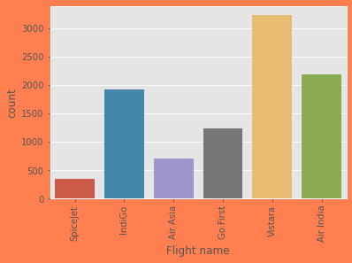
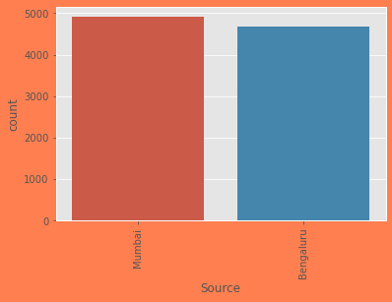
Most of the flight in the dataset is of 'Vistara' followed by 'Air India'.
The flight with Source location as 'Mumbai' are more in counting compare to 'Bengaluru'.

Slide 9
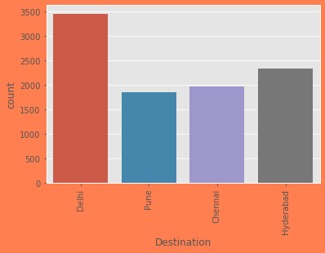
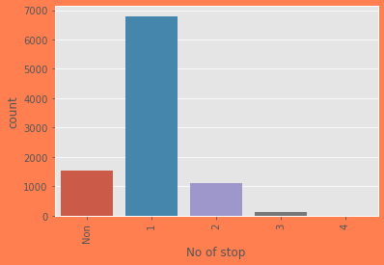
The flight with Destination location as 'Delhi' are most in counting.
The flight with 1 stop are most in counting.

Slide 10
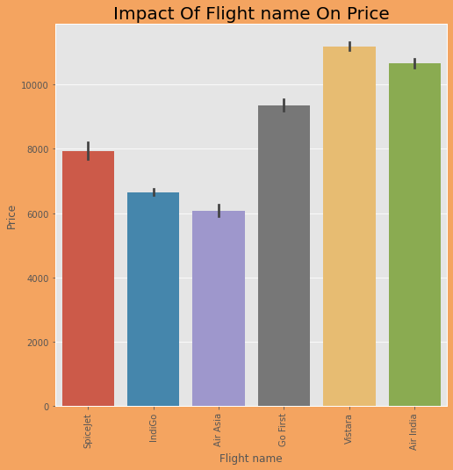
b).bivariate Analysis:
'Vistara' flight price are high, followed by 'Air India'.

Slide 11
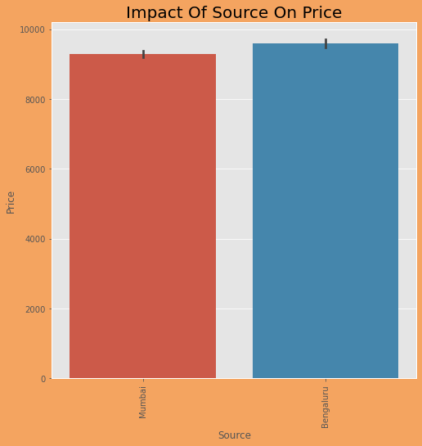
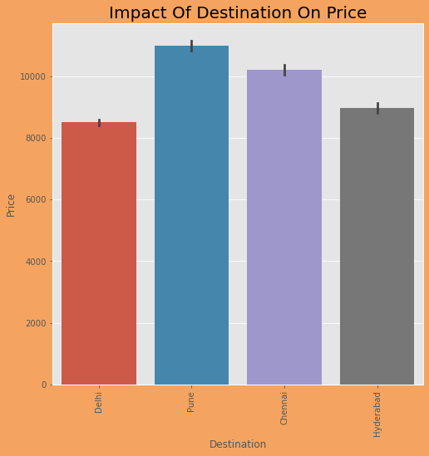
Those flight which has Source as 'Bengaluru' having high price.
Those flight which has Destination as 'Pune' having high price.

Slide 12
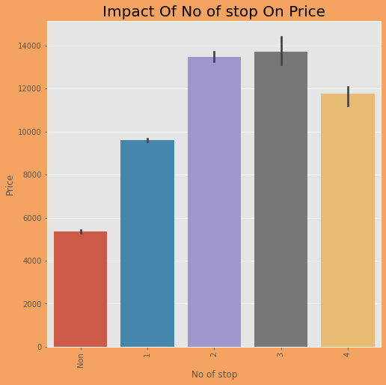
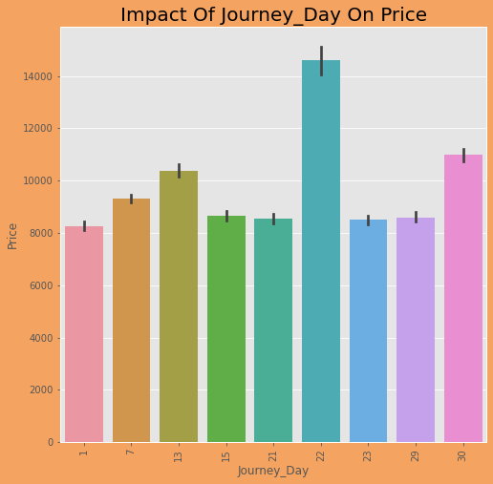
The flights with 2 and 3 stop having high price.
Tickets are expensive on date 22.

Slide 13
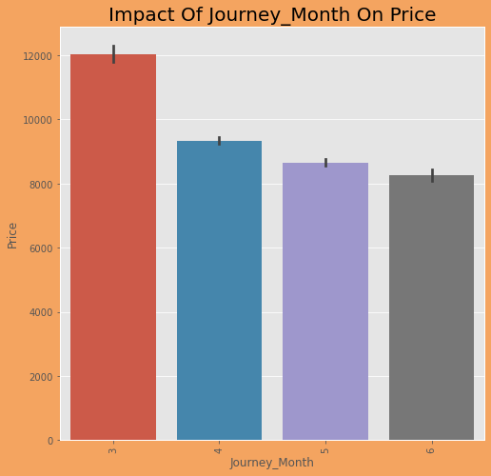
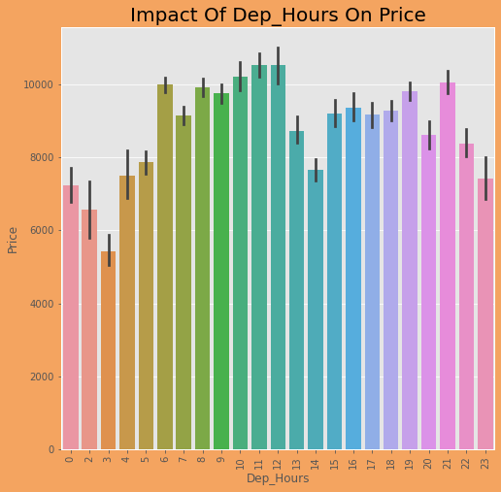
The prices are high if booking is done in same week of journey date.
In the Morning and Evening, flight tickets are expensive.

Slide 14
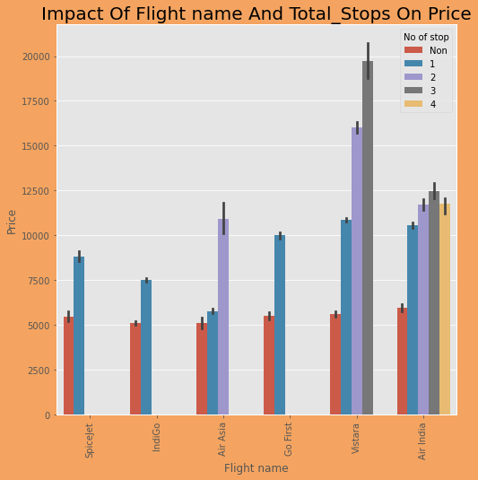
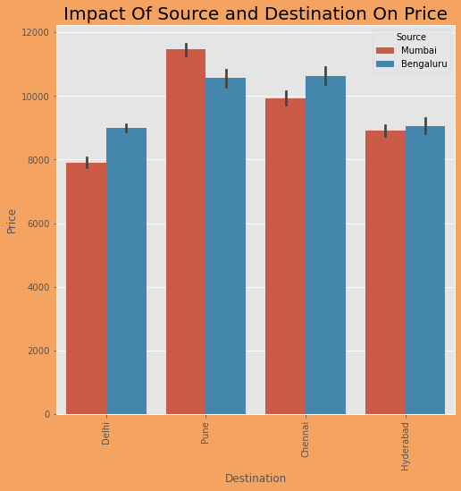
'Vistara' airline price is high when flight has 3 stop.
Mumbai to Pune flight ticket are most expensive ticket.

Slide 15
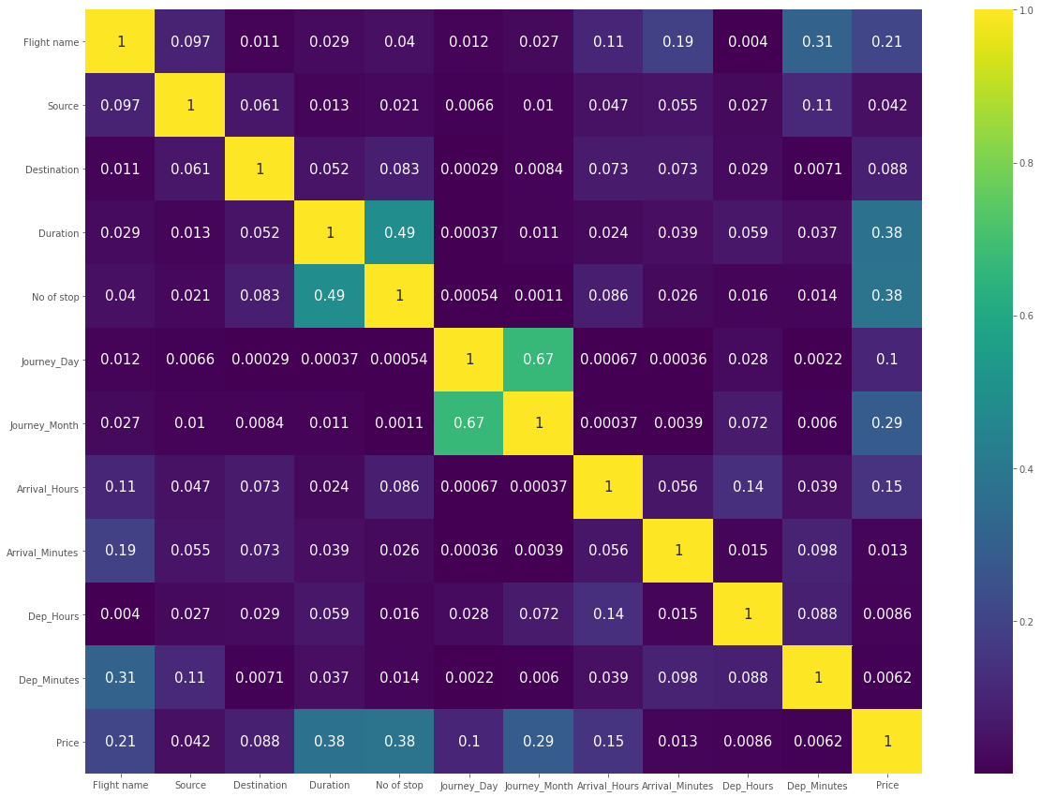
Correlation matrix of train dataset using Heatmap
Multicollinearity is not present in features of dataset.

Slide 16
Features Engineering
Dealing with Outliers
Only target has outliers. So, no need to worry about it.
Dealing with Skewness
Skewness is also not present in the dataset.
Encoding
‘Label encoder’ is used for encoding the object column.

Slide 17
Model Initiating
Find best Random State
Split dataset using Train_Test Split
Scaling the dataset
Removing Multicollinearity
Model Building
R2 Score
RMSE Score
Cross-Validation Score

Slide 18
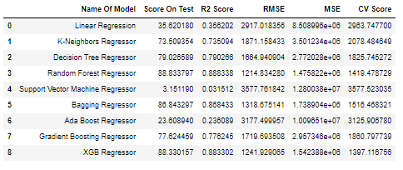
Scores of All Models
From the above figure, Random Forest Regressor & XGB Regressor have best R2 Score. The RMSE of Random Forest Regressor is less in compare to all. Based on R2 score & RMSE both model are good and also their cv score is better than other. CV score of XGB Regressor is less. So, I am choosing XGB Regressor as model for this data set because XGB Regressor has better r2 score, less RMSE score and good cross validation score.

Slide 19
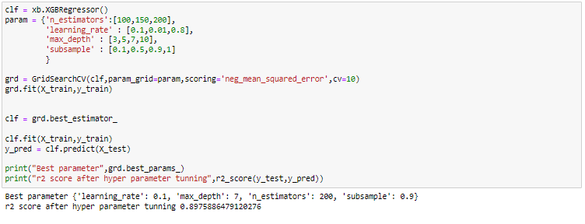
Hyperparameter Tuning
After hyperparameter tuning, I am able to improve the performance of my model. So fitted the model using best parameter to improve the performance of model.

Slide 20
Conclusion
I used total 9 algorithm to build the best model on this dataset.
Random Forest Regressor and XGB Regressor out of 8 model performed best on this dataset.
Comparing both models based on different metrics, XGB Regressor is final model on this dataset.
XGB Regressor gives 89.75% accurate prediction on dataset.
Airfares change during the morning and evening time of the day.
Airfares move in large jumps in the morning and evening time of the day.
Airfares are smallest when flight depart at 3 AM, after that fares go up.
Early morning and late night time are the best time to buy cheapest ticket.
Price increase as customers booked the ticket near to departure date i.e. last minute ticket are most expensive one.
Indigo is cheaper than Vistara and Air India Airways. AirAsia is cheapest flight.
Not all morning flights are expensive because 3 AM flights are smallest fare flights.

Slide 21
Thank You………

